Slide 1
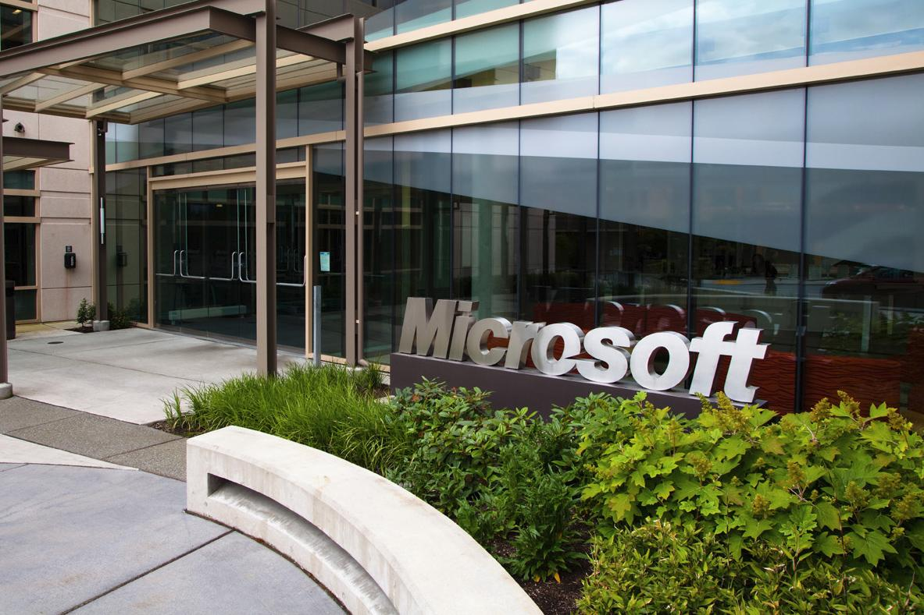

Microsoft’s Process
Redmond in the 90’s
Article by Roger Sherman, Director of Testing, Worldwide Products Group, Microsoft
Notes:
Microsoft headquarters image from http://www.digitaltrends.com/home/microsoft-just-launched-accelerator-program-home-automation-startups/#!bQ3tlS.
Article is from American Programmer, February, 1995.

Slide 2
An activity for your groups –
What did you think was interesting about MS process?
What did you like?
What didn’t you like?
What was surprising?

Slide 3
Why isn’t it waterfall?
Milestones
  Several per customer release
    Goal – fix bugs early
  Stages the features
  Acceptance testing toward the end of each
    Test release document – scope
  “Post-mortem” after each, also plans next
This is an “spiral” development approach
When “code complete” goes to mfg.
→

Slide 4
Let’s talk “requirements”
These are what you do “acceptance testing” against!
Final acceptance criterion – 5 days of testing without a “must fix” bug
Reliability = “code stability”
Microsoft’s “client” is a product manager
→ See next slide!

Slide 5
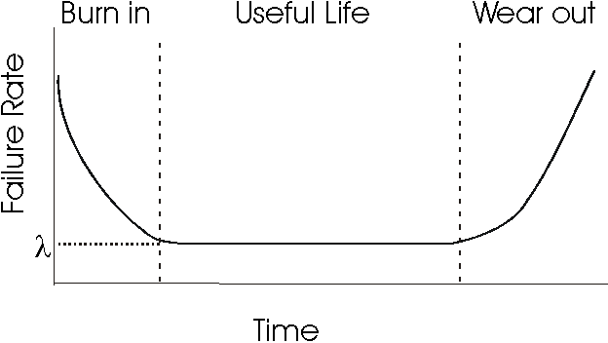
What is “reliability” here?
At Microsoft:
Rate at which the end user will encounter anomalies.
Goal is to maintain a product’s reliability while new features are being added.
And to increase reliability in the system testing phase until “good enough”.
Right – This is the classic reliability “U-curve” used in all of engineering. Does the “Wear out” phase happen with software?
“Bug convergence”
→
Notes:
Image from http://users.ece.cmu.edu/~koopman/des_s99/sw_reliability/

Slide 6
Let’s talk “requirements” - process
Vision statement
Analysis of competitors products
Satisfaction surveys
Annotated user studies
New technologies
Brainstorming to get great new features

Slide 7
From spec to schedule
Product specification
  Thought-up internally
Divided into features
Milestones
Judged against their
standards for:
Reliability
Schedule
Feature Set

Slide 8
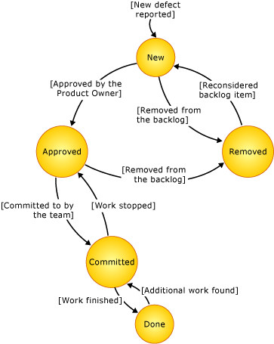
Tools
Source control – “Source Library Manager”
Bug tracking – RAID
  Does problem-resolution work-flow
  Also links issues to “release-ability” of the product
  And – can test hypotheses about causes!
Automated “project testing” by each developer
Putting “asserts” into debug versions of the code
Overnight “teacher pupil” test runs
  Automated tests – nearly 100% coverage
  UI testing with “monkeys”
Above – This is one of the bug tracking work flows you can choose today, built into Visual Studio.
Notes:
Image from http://msdn.microsoft.com/en-us/libraRy/ms400752(v=vs.110).aspx

Slide 9
Do they have Configuration Management?
Assumed to be a part of their bug resolution and feature selection processes for a release
Each developer also appears to have a “sandbox” for testing their own code in a build
→

Slide 10
Deciding what to launch
Emphasis on each of these dimensions varies, depending on the product!
Reliability – rate at which end user finds anomalies
Schedule – shipping on time
Feature Set – tied to vision of marketing group
→

Slide 11
Another activity for your groups – Take a position about MS!
For what Microsoft product would each of those 3 dimensions be number one priority!?
Reliability
Schedule
Feature Set
→

Slide 12
How many different kinds of testing are there at MS?
Teacher/Pupil
Automated Regression Testing
Beta Testing
Monkey Testing
Intelligent Monkey Testing
Resource Constraint Testing
Daily Build Testing
Smoke Testing
Likely a bit of manual testing although they don’t talk about it too much

Slide 13
What different forces does MS have on them, vs. more agile-oriented organizations?
They have to decide what works best, over a huge customer base
  E.g., tool bars vs menus vs hot keys
They are the “experts” on new features
  Propose these to management
  Must “exceed customer expectations” – want “best of breed”
  Their product experts challenge a product vision
Don’t put out partial products
  Do put out “betas”
High cost of recalls

Slide 14
Do you face the same issues as MS?
You’re developing products, not just custom work.
Someone plays the “product management” role.
  A surrogate customer.
  They absorb the risk in predicting acceptance.
Do you use similar sources of knowledge, like MS uses?

Slide 15
Management theory tangent – Product Manager
Typically manage a group of related products through their lifecycle.
  Might be called “program manager.”
  Includes coming up with new product ideas.
  Become “product champions.”
Responsibilities vary widely.
  May or may not be responsible for marketing.
  May or may not hold the purse strings.
Usually they have an “industry background” vs a technical background.
  But they need to know what development is capable of doing!

Slide 16
How they are positioned relative to us
Us developers, that is.
And everyone else:
Research
Tech transfer
Our products
Our relationship
Customers
Exploration
Development
Product
management
Marketing
Knowledge flows

Slide 17
Update on Microsoft’s Process
See https://www.cs.duke.edu/courses/fall98/cps108/slides/MSdev.pdf
They are now somewhat agile.
  Depends on the group.

Slide 18
Your questions from the reading quiz
My pick
Your choice

